Slide 1
Notes on Bootstrapping

Slide 2

Why do we bootstrap?
What happens when we have a small skewed data set? The methods we have learned so far do not apply. We would either have to use a non parametric method or we can boot strap!
This Photo by Unknown Author is licensed under CC BY-SA

Slide 3
What is Bootstrapping?
The bootstrap was developed by Bradley Efron in the late 1970s as a way to calculate estimations in situations where statistical theory does not produce a formula for a confidence interval.
The method substitutes heavy computation for theory.
We take many, let’s say 1000 samples of size n and find the mean of each sample. Then we use the distribution of these 1000 means to get a confidence interval of the population mean.
Let’s try this with one population.

Slide 4
Example
In a student project, Erich Brandt studied tips at a restaurant. Here is a random sample of 30 observed tip percentages:
22.7, 16.3, 13.6, 16.8, 29.9, 15.9, 14, 15, 14.1, 18.1, 22.8, 27.6,
16.4, 16.1, 19.0, 13.5, 18.9, 20.2, 19.7, 18.2, 15.4, 15.7, 19, 11.5, 18.4, 16, 16.9, 12, 40.1, 19.2
We would like to get a confidence interval for the population mean tip percentage at this restaurant. Let’s check our assumptions!

Slide 5
Normal Probability Plot
#qq plot
tips<-sort(tips)
n<-length(tips)
#percentiles
P<-0
for (i in 1:n){
P[i]<-(100*(i-.5)/n)/100
}
Z<-0
for (i in 1:n){
Z[i]<-qnorm(P[i])
}
plot(Z,tips)
#The line of comparison
qqline(tips)

Slide 6
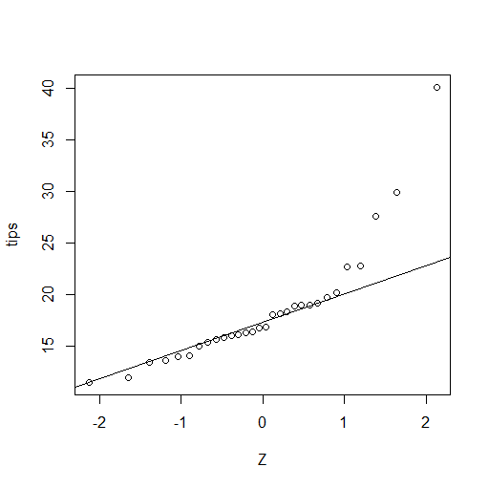
Normal Probability Plot
The sample is skewed and the sample size is small. We can not use the formula to find the confidence interval.

Slide 7
Let’s bootstrap
First, how do we even sample with replacement?
data<-sample(tips, 30, replace = TRUE, prob = NULL)
We want to take 999 samples, so let’s create an empty matrix with 999 rows and 30 columns. Each row, we will fill with one of the samples we generate
datamat<-matrix(0,nrow=999,ncol=30)

Slide 8
For loops
Next we create a for loop that will sample with replacement from the 30 tip percentages and then fill that empty matrix
for (i in 1:999){
datamat[i,]<-sample(tips, 30, replace = TRUE, prob = NULL)
}

Slide 9
Find the means
Now we can easily find the mean of each of the rows
Means<-0
for (i in 1:999){
Means[i]<-mean(datamat[i,])
}

Slide 10
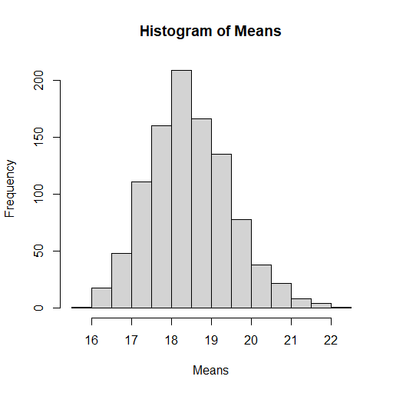
Let’s look at the distribution of the means
hist(Means)

Slide 11
Probability Plot of the means
#probability plot
Means<-sort(Means)
N<-length(Means)
PP<-0
for (i in 1:N){
PP[i]<-(100*(i-.5)/N)/100
}
ZZ<-0
for (i in 1:N){
ZZ[i]<-qnorm(PP[i])
}
plot(ZZ,Means)
#The line of comparison
qqline(Means)

Slide 12
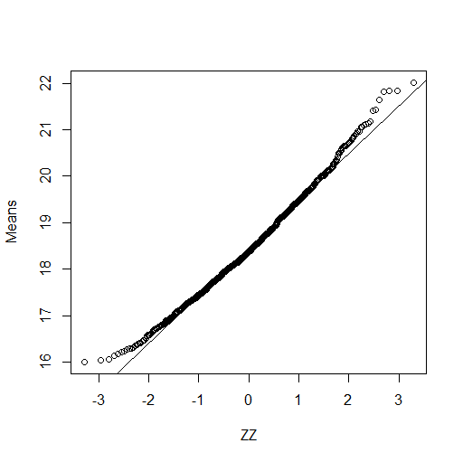
The distribution of the means is normal

Slide 13
The CI of the population mean
mean(Means)
sd(Means)
18.466+(1.96)*(1.05)
18.466-(1.96)*(1.05)
qnorm(.025)
qnorm(.975)

Slide 14
Two Samples
Let’s repeat this process for two samples.
Consider the data from a study of children talking to themselves. The children were observed in many 10s intervals (about 100) and the researches computed the percentage of the intervals in which private speech occurred. Because private speech tends to occur when there is a challenging task, the students were observed when they were doing arithmetic. The private speech is classified as on task if it is about arithmetic, off task if it is about something else, and mumbling if the subject is not clear.
Each child was observed in the first, second, and third grades, but we will consider here just the first grade off-task private speech. For the 18 boys and 15 girls here are the percentages:
B: 4.6, 5.5, 6.5, 0.0, 0.0, 3.0, 2.8, 6.4, 1.0, 0.9, 0.0, 28.1, 8.7, 1.6, 5.1, 17.0, 4.7, 28.1
G: 0.0, 1.3, 2.2, 0.0, 1.3, 0.0, 0.0, 0.0, 0.0, 3.9, 0.0, 10.1, 5.2,3.2, 0.0

